Slide 1



at HOME
in KAINUU
INTERNATIONAL INFO FOR PROFESSIONALS, STUDENTS AND FAMILIES

Slide 2



EARLY CHILDHOOD CARE AND COMPULSORY SCHOOLING IN FINLAND
from a kindergarten kid to a youngster in basic education
26.1.2021 I ONLINE INFO
The event is organized by TOPPA project in cooperation with Early Childhood Education and Care & Basic Education Services, City of Kajaani. TOPPA project is funded by the European Social Fund (ESR). Facebook City of Kajaani - International Info I LinkedIn I kajaani.fi I #athomeinkainuu

Slide 3
Early childhood care and education in Finland:
an important stage on the child's path of growing, developing and learning - together towards good life

Slide 4

Early childhood education and care
The purpose and general objectives of early childhood education and care
The purpose of early childhood education and care is to promote the overall growth, development and learning of children together with the parents or carers.
Early childhood education and care promotes the equality of children and prevents social exclusion.
The knowledge and skills acquired in early childhood education and care promote inclusion and active agency in the society.
In addition, early childhood education and care supports parents and carers in their parenting task and enables them to work or study.
Subjective right to day care means that children are entitled to early childhood education and care even if their parents do not work or study full time or are not entrepreneurs.

Slide 5
Early childhood education and care
Early childhood education and care is intended for pre-school aged children between 0 and 6 years of age.
Early childhood education and care is provided by municipal and private day care centres.
At the day care centre, children are divided into groups based on their age, sibling relations or need for support, among other things.
Groups of children below 3 years of age have 4 children/adult, and groups of children above 3 years of age have 7 children /adult.
In addition, there are private childminders who care for children in their own homes (4 children/carer).
Open early childhood education and care can be arranged at playgrounds or as clubs for children between 3 and 5 years of age who do not need regular day care.
Day care can be provided for the children of shift workers or students at day care centres or by private childminders in the evenings, on weekends or at night.

Slide 6
Early childhood education and care
Trained day care centre directors, early childhood education and care providers and childminders, and assisting staff work in early childhood education are care.
Special needs teachers work in the groups as required.
In Kajaani, migrant services coordinator for early childhood education and care guides and advices families and staff.
Early childhood education and care workers operate in cooperation with parents and carers. All child-related issues can be discussed with the staff.
The staff is bound by a secrecy obligation.

Slide 7
Early childhood education and care
Early childhood education and care consists of education, instruction and care.
It has been pedagogically designed and its objectives have been carefully considered.
Play, and learning through play, are central.
Playing motivates children and brings them joy.
While children play, they learn many skills and digest information they need at day care, in school and in their future lives.
Playing improves imagination, helps them concentrate and develops their empathy.
Playing teaches flexibility and orderliness.
Playing teaches children to cope with disappointment and to wait for their turn.
It is also important to learn to talk, agree and plan with other children.

Slide 8
Early childhood education and care
In Finland, early childhood education and care are governed by the national core curriculum for early childhood education and care and the Act on Early Childhood Education and Care.
Children are entitled to methodical and goal-oriented education, instruction and care.
Municipalities also have their own local curriculum for early childhood education and care.
Cooperation between parents and carers and the staff is very important.
A personal early childhood education and care plan shall be prepared for each child together with staff members and the child’s parent /carer. The pedagogic aims shall be recorded in the plan (methodical and goal-oriented activity to foster well-being and learning).
When the personal early childhood education and care plan is drawn up,
it is important to know the skills, strengths, interests and individual
needs of the child.
In addition, the child’s linguistic, cultural and religious background
shall be considered.

Slide 9
Early childhood education and care
Supporting development and learning is part of quality early childhood education and care, and all children who need support are entitled to it.
A child’s need for support is identified in early childhood education and care, and appropriate support is provided, if required, in multiprofessional cooperation with a special education teacher in early childhood education and care, child welfare clinic, physician, psychologist and speech therapist.
Children are also entitled to pupil welfare services from a school nurse, school social worker and school psychologist.
The aim of early childhood education and care is to ensure that each child feels accepted as they are and as a member of a group.
Kajaanin Vasu perusteet – esite huoltajille
Curriculum for early childhood education and care in Kajaani –
brochure for parents and carers (English)
Kajaanin Vasu perusteet – esite huoltajille (arabia)
Kajaanin Vasu perusteet – esite huoltajille (venäjä)

Slide 10

Pre-primary education
Pre-primary education takes place during the year preceding primary education.
According to the Basic Education Act (section 26a), the parent or carer shall ensure that the child participates in pre-primary education or other activity in which the aims of pre-primary education are attained.
The aim of pre-primary education is to support the child’s learning, development and growth and to prepare the child for school.
The methods used in pre-primary education are play, experimenting and studying as well as creative activities with adults and peers.
Cooperation between parents/carers, children and
pre-primary education staff is important.
Cooperation takes place by means of discussions, information bulletins, parents’ evenings and events. Information is provided through websites, blogs, social media, and various types of electronic services and applications as decided by each municipality.

Slide 11
Pre-primary education
A pre-primary education plan is prepared in cooperation with the child and the parents/carers.
The growth and learning objectives of the child, teaching arrangements, and the support and guidance needed by the child shall be entered in the plan.
The information on the child recorded during pre-primary education will be transferred for use in basic education (by the permission of parents/carers) to enable a continuous school path.
A multiprofessional team will make an overall assessment of the child’s preparedness to start mainstream education, instruction preparing for basic education, or special education.

Slide 12
Pre-primary education
Integrative instruction – Multidisciplinary modules – Interests of the child
Music, visual arts, crafts, verbal and physical expression
Linguistic skills
Historical, social, ethical and religious education
Mathematical skills, technological and environmental education
Physical education, food and moderate consumption, well-being, health and safety

Slide 13
Pre-primary education
Pre-primary education (4 h/day) is free of charge.
If the child is also in day care, a client fee for early childhood education and care is charged.
The fee is determined according to the family income and hours spent in day care.
Pre-primary education follows the school holidays.
Kajaanin kaupungin esiopetus – infoa huoltajille
Pre-primary education in Kajaani – information for parents/carers (English)
Kajaanin kaupungin esiopetus – infoa huoltajille (arabia)
Kajaanin kaupungin esiopetus – infoa huoltajille (venäjä)

Slide 14

Multi-cultural early childhood education and care and pre-primary education
The early childhood education and care and pre-primary education for children who speak a foreign language or multiple languages are part of the general early education services.
The importance of the child’s native language and culture as well as learning Finnish are taken into account in early education and pre-primary education together with the parents/carers.
Finnish as a second language (S2) is taught in everyday interaction and in guided activities.
Tuition in native language is provided for pre-primary pupils in basic education groups, as far as possible.
The use of an interpreter is important in all negotiations. Both the parents/carers and early childhood education and care staff are entitled
to an interpreter.

Slide 15

Applying for early childhood education and care
A place in early childhood education and care shall be applied for no later than four months before the child needs the place.
If the need for early childhood education and care is due to employment or studies, a place shall be applied for no later
than two weeks before the child needs the place.
A separate application shall be submitted for each child.
The application for early childhood education and care
is valid for a year of the date when the application was received.

Slide 16
eAsiointi (e-service) in early childhood education and care
By using the e-service in early childhood education and care you can:
Submit an application for municipal early childhood education and care and play groups.
Register for pre-primary education. If the child needs early childhood education and care in addition to pre-primary education, you must also apply for early childhood education and care.
Apply for a service voucher for private early childhood
education and care.
Report the daily care times to municipal early childhood
education and care providers.

Slide 17
Applying for early childhood education and care and
registering for pre-primary education
Municipal day care or a place in pre-primary education can also be applied for with a written application.
If a family opts for a private day care centre or family day care,
the city will provide the family with an early childhood education and care service voucher.
When the family has made an agreement with a private day care centre or childminder, the service voucher is applied for online.
A service voucher application is submitted for each child separately.
The fee is the same as in municipal day care, if the private service
provider does not charge extra.

Slide 18

Client fees for early childhood education and care
The client fee for early childhood education and care is a fixed monthly payment.
The fee is determined according to the family income and number of family members.
Families shall submit information on their income within two weeks of the start of early childhood education and care.
If the family does not provide the income information, the fee will be the maximum fee.
The fee is adjusted annually.
The fees will be billed monthly in arrears.
Changes in family income or conditions shall be reported
to the early childhood education and care provider.

Slide 19

Morning and afternoon activities for pupils
For first and second year pupils in basic education, and other pupils in need of special support.
The requirement is that both parents/carers are employed or study.
The activities are organised by municipalities in cooperation with organisations and associations.
The activities take place in the mornings before school and in the afternoons after school.
No cost-free school transportation is provided for pupils who attend morning or afternoon activities.
The pupils are served a nutritious snack during the afternoon activities.

Slide 20
Morning and afternoon activities for pupils
Application takes place with the online Wilma service or with a paper form annually when registering for school.
The fee for morning and afternoon activities is a fixed monthly payment.
For those who provide income information, the fee is determined according to the family income and number of family members.
Plan for morning and afternoon activities in basic education

Slide 21
KIITOS!
Thank You!
Kuvat Perttu Penttinen

Slide 22
Basic education in Finland –
youngsters path in compulsory schooling

Slide 23

Instruction preparing for basic education
Some Finnish municipalities provide immigrants with instruction preparing for basic education.
Instruction preparing for basic education:
Smaller group, in which the pupil can improve his/her Finnish skills to an adequate level before starting mainstream education.
Instruction preparing for basic education:
https://www.oph.fi/sites/default/files/documents/perusopetukseen-valmistava-opetus.pdf

Slide 24
Basic education
The purpose and general objectives of basic education
Education and upbringing:
  The objective of basic education is to support the pupils’ learning, development and well-being in cooperation with homes.
Society:
  The objective of basic education is to promote equality and justice.
Culture:
  The objective of basic education is to promote varied cultural skills and the appreciation for cultural heritage, and to support pupils in developing their cultural identity and improve their understanding of cultural diversity.
Future:
  The objective of basic education is to teach pupils to take responsibility for their choices shaping the future.

Slide 25

Basic education
All children permanently living in Finland are entitled to basic education.
Compulsory education: 7–18 years of age. (as of 2021)
Basic education:
  Primary education (1–6) and
  lower secondary education (7–9).
After basic education:
  Upper secondary education: general upper secondary school
  or vocational college
Basic education is free of charge.
  It also includes textbooks, materials and equipment needed, and school lunch and insurance for the duration of the school day, school transportation and field trips.
  As of 2021, upper secondary studies will also be free of charge.

Slide 26

Basic education
Curriculum = the content of instruction
A national core curriculum for basic education is prepared by the Finnish National Agency for Education.
A local core curriculum is prepared by the municipality based on the national core curriculum.
Schools prepare
  their own annual plans for the implementation of the local curriculum, and
  individual learning plans for the pupils.
National core curriculum for basic education:
https://www.oph.fi/sites/default/files/documents/perusopetuksen_opetussuunnitelman_perusteet_2014.pdf
Local curriculum, Kajaani: http://www.kajaani.fi/sites/default/files/ops_2016_opetus_ja_oppiaineet.pdf

Slide 27
Basic education
Basic education encompasses 20 subjects.
In addition, there are transversal studies and elective subjects.
Theoretical subjects:
Native language and literature,
mathematics,
second domestic language and foreign languages
environmental studies,
biology and geography,
physics and chemistry,
history and civics,
religion,
ethics,
health education.
Artistic and practical subjects:
Visual art,
home economics;
crafts,
physical education,
music.

Slide 28
Basic education
Assessment
The pupils’ learning, working and conduct are assessed during the studies and at the end of the school year.
Pupils get a report card at the end of the school year.
The report card consists of the curriculum and a verbal assessment or numerical assessment of each subject.
The assessment reveals
• the learning aims,
• what has been learned,
• how the pupil can improve his/her learning and achievement.
• 1st and 2nd year pupils get a verbal assessment.
It details how the child has progressed in all subjects studied during the school year.
• In years 3 to 9, teachers use numerical assessment 4–10.

Slide 29
.

Slide 30
Basic education
Teachers and other school staff
• Headteacher (+ DEPUTY HEADTEACHER)
• Teachers
• Classroom assistants/special needs assistants
• School nurse
• School welfare officer
• School psychologists
• School secretary
• Canteen staff
• Cleaning staff
• (Before- and after-school activities instructors)

Slide 31
Basic education
Learning support
Who?
Teachers, parents/carers, pupil, other school staff (e.g. school welfare officer, school nurse, school psychologist)
Where?
At school; own classroom or office of staff member
When?
Annual evaluation; more often, if needed
Why?
Support prevents problems and helps the pupil to find the most convenient ways to study.

Slide 32
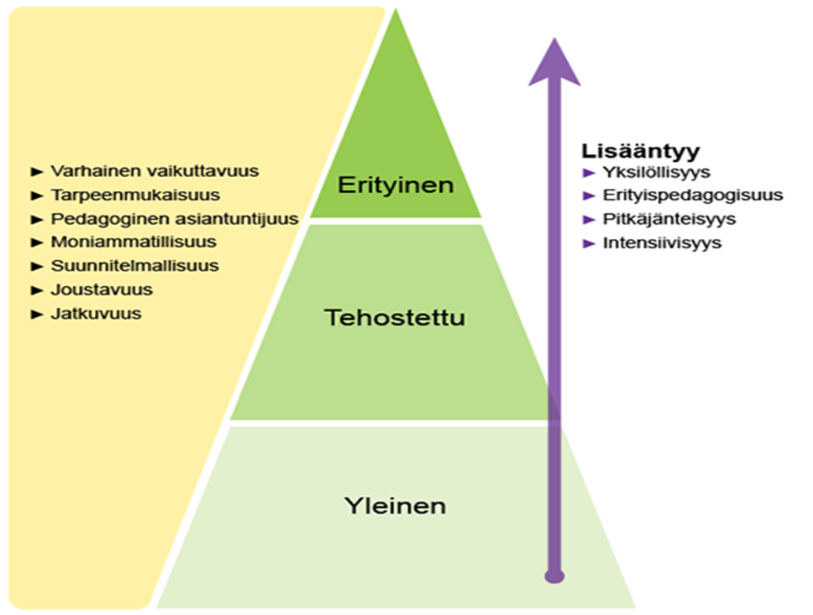
Basic education
Three-step support in basic education
general support
2. intensified support
3. special support

Slide 33
Basic education
Pupil welfare
Who?
Teachers, guidance counsellors, school nurse, school welfare officer and school psychologist.
Pupil and family.
Where?
At school.
When?
All the time.
How?
The well-being of pupils is observed and evaluated.
The group is observed in the classroom during the school day.
Discussions are held at school and with parents.
Pupils are helped to find the right services, if they have troubles.

Slide 34
Basic education
Cooperation between home and school
Communication between home and school is important. Homes shall keep the school informed, and vice versa.
The teacher and the pupil’s family communicate regularly by telephone or using the Wilma online system.
Physical punishment is not allowed in Finland.
In problem situations, teachers speak with the child and the family.
Each child is entitled to bodily integrity.

Slide 35
Basic education
Cooperation between home and school
What should the teacher know?
Contact the school first thing in the morning, if the child is ill,
if the family goes on a trip and the child will be absent from day care/school, the school shall be informed in advance. Absences of more than 3 days shall be requested from the headteacher.
if the family address or telephone number change,
if the child is diagnosed with a chronic disease requiring treatment (e.g. allergy, diabetes),
if the child says that he/she has been bullied at school or during the trip to school.

Slide 36
Basic education
Cooperation between home and school
The parents’ duties:
To ensure that the child is properly dressed and has all the required equipment.
To take care of transportation, if the child attends an after-school activity, for example.
To take care of the child’s basic needs (healthy food, sufficient sleep, hygiene).
To help and assist the child with school work (help with homework, encourage, contact the teacher, if needed).
To ensure that the child does not spend too much time on mobile devices.
Parents shall also ensure that the child spends time outdoors every day.
To be a safe adult for the child and to participate in the child’s everyday life, for example, by asking him/her to tell about the school day.

Slide 37
Suomalainen koulutusjärjestelmä

Slide 38

KIITOS!
Thank You!
Kuvat Perttu Penttinen

